Slide 1

T99X171.00 Control Run Test Yield Rate
Prepare by: PE- Phuong
Date: September 01st 2021

Slide 2
Control Run Content
1. Background Information :
Need build control run to verify 2nd source with P/N: 027.01504.005 (TPL740F18) and P/N: 027.01502.005 (TPL740F25) of 3PEAK vendor.
Quantity: 100pcs
No.# | Main source | 2nd source | Location | Describe Material | Vendor 2nd source
1 | 027.01468.005 | 027.01504.005 | U303, U306 | TPL740F18 Input Voltage Range 2.4 V to 5.5 V Output Voltage: Fixed 1.8V Operating junction temperature −40°C to +85°C | 3PEAK
2 | 027.01469.005 | 027.01502.005 | U307 | TPL740F25 Input Voltage Range 2.4 V to 5.5 V Output Voltage: Fixed 2.5V Operating junction temperature −40°C to +85°C | 3PEAK
2. Purpose:
Due to main source of DIODE vendor shortage seriously, need build control run to check function of 2nd source material P/N: 027.01504.005 (TPL740F18) and P/N: 027.01502.005 (TPL740F25) of 3PAEK vendor.

Slide 3
Control Run Procedure
1. Process as below:
Kitting ==> SMT ==> AOI ==> X-ray ==> PTH ==> Link ==> UK ==> Assembly ==> FT ==> FT1 ==> Burn in 20% ==> RC ==> RC1 ==> Power on/ off 30 times( on: 3min/ off: 30s) ==> OBA 100% ==> RC2 ==> ORT ==> VI ==> Packing ==> FG
Step | Items | Contents | Remark
1 | Kitting | Provide material to do control run
2 | SMT | Surface mounting technology | Check first PCB to make sure control run material
3 | AOI | AOI 100% PCBA before and after Re_flow | Make sure none process issue
4 | X-ray | X-ray 100% | Take X-ray 100% to check solder short
5 | PTH | Paste through hole | Check VI material polarity
6 | FATP | Focus on new material location U303, U306 with P/N: 027.01504.005, U307 with P/N 027.01502.005. | Check if NG products are related to 2nd source material, confirm symptom & FA report.
7 | Power on/off | 100% power on /off 30times (on : 3 mins/ off : 30 seconds)
8 | OBA ( 100%)➔ RC2➔ VI➔ Packing➔ FG | Check function of products

Slide 4
Voltage measurement
1. Power supply measurement.
Measure power supply of product is used 2nd source and product is used main source.
Voltage measurement
Location (Voltage power spec +/-5%VCC) | Main soucre | 2nd source | Result
U303(1.8V) | 1.790V | 1.799V | Pass
U306(1.8V) | 1.80V | 1.792V | Pass
U307 (2.5V) | 2.501V | 2.498V | Pass
Summary:
- Value voltage of product is used 2nd source within specification.<5%VCC and no abnormality

Slide 5
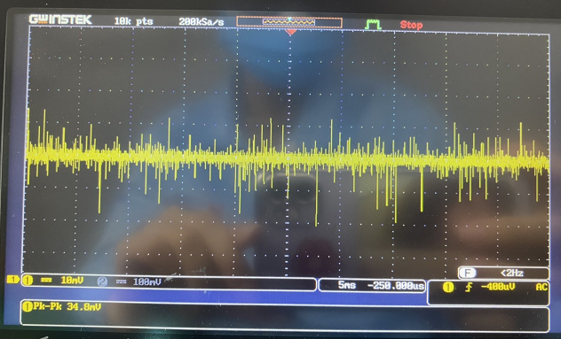
Voltage Ripple measurement
1. Power supply measurement.
Measure voltage ripple of product is used 2nd source and product is used main source.
Voltage ripple measurement
Power | Voltage ripple spec(<5%VCC) | Measure location | Main source | 2nd source | Result
U303(1.8V) | <90mV | C322 | 36.8mV | 38.8mV | Pass
U306(1.8V) | <90mV | C337 | 39.6mV | 34.8mV | Pass
U307(2.5V) | <125mV | C334 | 57.6mV | 43.6mV | Pass
Voltage ripple of product used 2nd source U306_( 1.8V)
Summary:
- Value voltage ripple of product is used 2nd source within specification.<5%VCC and no abnormality

Slide 6

Test Yield Rate
OTT |  |  | Model Name: T99X171.00
 |  |  | Quantity: | 100pcs
 |  |  | Version | 09L2C
 |  |  | Production image | k000a-t8a_fac_BFX-AT100
 |  |  | Customer image | 15.523.6
 |  |  | MO | 2643000448
 |  |  | Date | 9/01/2021
1.Product Yield & FA Report
Customer | Product Model | Test Station |  | Yield Rate | Statistical | Yield Rate
OTT | T99X171.00 | UK |  | 100.00% | Total | 100
 |  |  |  |  | Pass | 100
 |  |  |  |  | Fail | 0
 |  |  |  |  | Yield Rate(%) | 100%
 |  | FT |  | 100.00% | Total | 100
 |  |  |  |  | Pass | 100
 |  |  |  |  | Fail | 0
 |  |  |  |  | Yield Rate(%) | 100%
 |  | FT1 |  | 100.00% | Total | 100
 |  |  |  |  | Pass | 100
 |  |  |  |  | Fail | 0
 |  |  |  |  | Yield Rate(%) | 100%
 |  | RC |  | 100.00% | Total | 100
 |  |  |  |  | Pass | 100
 |  |  |  |  | Fail | 0
 |  |  |  |  | Yield Rate(%) | 100%
 |  | RC1 |  | 100.00% | Total | 100
 |  |  |  |  | Pass | 100
 |  |  |  |  | Fail | 0
 |  |  |  |  | Yield Rate(%) | 100%
 |  | RC2 |  | 100.00% | Total | 100
 |  |  |  |  | Pass | 100
 |  |  |  |  | Fail | 0
 |  |  |  |  | Yield Rate(%) | 100%
 |  | Final Yield Rate(%) |  | 100.00%

Slide 7
Conclusion
The final test yield rate is : 100%.
Base on test burn in 8 hours result 20pcs, power on/off & test OBA result 100pcs : Don’t find out any product function fail & boot up fail related to 2nd source material P/N: 027.01504.005 (TPL740F18) and P/N: 027.01502.005 (TPL740F25) of 3PEAK vendor.
Control run result is Pass. Factory can apply for MP

